Slide 1


DESIGNING A COST-EFFECTIVE, COMPACT SOLUTION FOR HOUSEHOLD WASTE SEGREGATION
TEAM MEMBERS :
822421106049 – PRIYADARSHINI V
822421106063 – SHARMILA J
822421106067 – SIVASANKARI M
IV YEAR ECE - B
GUIDE :
Mr. D.SURESHKUMAR M.E.,
ASSISTANT PROFESSOR/ ECE
MRK INSTITUTE OF TECHNOLOGY
KATTUMANNARKOIL , CUDDALORE – 608 301.

Slide 2
PROBLEM STATEMENT
Waste mismanagement is a growing environmental concern, which leads to increased landfill waste, pollution, and inefficient recycling processes.
Manual sorting is time-consuming, unhygienic, and often inaccurate.
Existing automated solutions are compact, cost-effective, and automated waste segregation system is needed.
Smart sensors and simple mechanical sorting techniques to efficiently classify and dispose of household waste.

Slide 3
ABSTRACT
A cost-effective and compact automated waste segregation system for household use.
It utilizes sensors (TTP223B, HC-SR04, IR) to identify waste types and a microcontroller ESP32 is used for processing.
A mechanical sorting mechanism directs waste into Non-Biodegradable, Biodegradable & metal bins.
It reduces manual effort and promotes efficient waste management.
It is designed to be affordable, easy to implement, and scalable.

Slide 4
OBJECTIVES
To develop a household use for automated waste segregation system.
To integrate sensors and microcontrollers for accurate classification of Biodegradable, Non-Biodegradable and Metal waste.
To improve waste management efficiency and accuracy through automated sorting and segregation.
To promote sustainable waste disposal practices and enable future enhancements like IoT-based monitoring and AI classification.

Slide 5
INTRODUCTION
Improper waste segregation causes pollution and recycling inefficiencies, Manual sorting is ineffective and moreover the cost of labor is also high.
This system uses (TTP223B, HC-SR04, IR) sensors and ESP32 to automate the process, reducing landfill use and improving recycling.
Designed for easier to use at home.

Slide 6
LITERATURE SURVEY
S.No | AUTHOR NAME | TITLE | YEAR OF PUBLISHED | REMARKS
1. | Joby Roy, Arinash C, Akash N, Aslam Niyas | DOMESTIC WASTE MANAGEMENT | 2024 | Raspberry Pi based system for waste disposal
2. | Cody Allen | THE ECONOMIC AND ENVIRONMENTAL BENEFITS OF EFFICIENT WASTE MANAGEMENT | 2023 | The purpose of this project is he positive impacts of efficient waste management practices on both the economy and the environment.
3. | Madhuri K. Pejaver, B. N. Bandodkar | COST EFFICACY OF HOUSEHOLD WASTE MANAGEMENT | 2023 | Urban solid wate management in development of Indiaon basis of health care and econamy.
4. | Manus Coffey | COST-EFFECTIVE SYSTEMS FOR SOLID WASTE MANAGEMENT | 2023 | Inefficient solid waste management (SWM) can be a more serious health hazard than the sanitation wastes from on-site sanitation systems
5. | Ayodeji A. Noiki 1&2 , Sunday A. Afolalu | IMPACT ASSESSMENT OF THE CURRENT WASTE MANAGEMENT PRACTICES IN NIGERIA | 2019 | The existing waste management methods are ineffective and the demand for an all-inclusive waste management approach, proper execution, and enforcement of environmental regulations and laws.
6. | David J. Tonjes, Sreekanth Mallikarjun | COST EFFECTIVENESS OF RECYCLING: A SYSTEMS MODEL | 2013 | Imply that increases in recycling are justifiable due to cost- savings alone, not on more difficult to measure factors that may not impact program budgets

Slide 7
EXISTING SYSTEM
Current waste segregation practices are leading to contamination of recyclable materials and increased environmental burden. Lack of proper sorting mechanisms hampers effective recycling and contributes to unsustainable disposal methods.
Old Sorting method – Time-consuming, unhygienic, and prone to human error.
Limited Automation – Existing automated systems are expensive and impractical for household use.
Inefficient Classification – Lack of proper sensor integration results in inaccurate segregation.
High Landfill Waste – Poor segregation leads to increased landfill accumulation and environmental pollution.

Slide 8
DEMERITS OF THE EXISTING SYSTEM
Inaccuracy in Segregation – Improper classify waste leading to ineffective recycling.
Expensive Automation – Existing automated solutions are costly and not suitable for household use.
Increased Landfill Waste – Poor segregation results in dumped landfills, causing environmental pollution.
Lack of Smart Features – No IoT integration for monitoring or AI-based classification, limiting efficiency.

Slide 9
PROPOSED SYSTEM
It is a Automatic,Compact, affordable system for household waste segregation.
Sensors like(TTP223B,HC-SR04,IR) for real time waste detections and classification.
ESP32 microcontroller processes input from sensors and directs waste to appropriate bins using a motorized sorting mechanism.
Improves accuracy, reduces poor waste segregation & landfill waste.
It is easily upgradable to IoT and AI for smarter waste management.

Slide 10
MERITS OF THE PROPOSED SYSTEM
Automated and Accurate Segregation – Utilizes Capacitive(TTP223B), ultrasonic sensor(HC-SR04), IR sensors for precise waste classification.
Lowers Human Effort - Simplifies the sorting process, enhances hygiene, and reduces exposure to health hazards.
Promotes Recycling and Sustainability – It is a Eco-friendly approach effective recycling and Helps minimize landfill waste.
Future Scalability – Architecture allows easy integration of IoT modules for live status updates and potential Al enhancements for advanced smart waste.

Slide 11
HARDWARE REQUIREMENTS
6) Power Supply Module
7) Buzzer
8) Wires & Connectors
Waste Bins
Structural Frame
ESP32 Microcontroller
IR Sensor
Capacitive Sensor (TTP223B)
Servo Motors
Ultrasonic Sensor(HC-SR04)

Slide 12
SOFTWARE REQUIREMENTS
Thonny IDE ( Software).
Python3 ( Programming Language ).

Slide 13
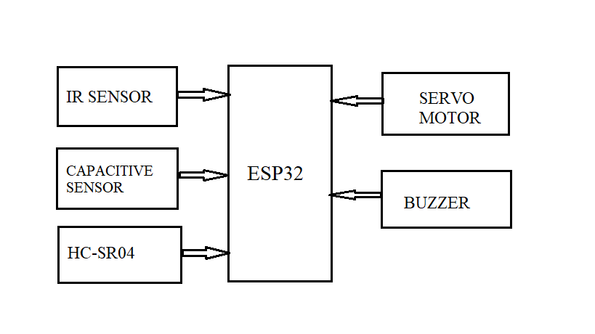
BLOCK DIAGRAM
TTP223B

Slide 14
BLOCK DIAGRAM DESCRIPTION
IR Sensor – Detects and helps different materials based on optical properties.
HC-SR04 Sensor– detect the placing of dust.
TTP223B Sensor – Identifies non-conductive materials like plastics and paper.
ESP32 Microcontroller–Processes sensor data makes waste classification decisions and controls actuators.
Servo Motor – Moves sorting gates to direct waste into appropriate bins.
Buzzer – Provides an alert sound when waste is classified or an error occurs.

Slide 15
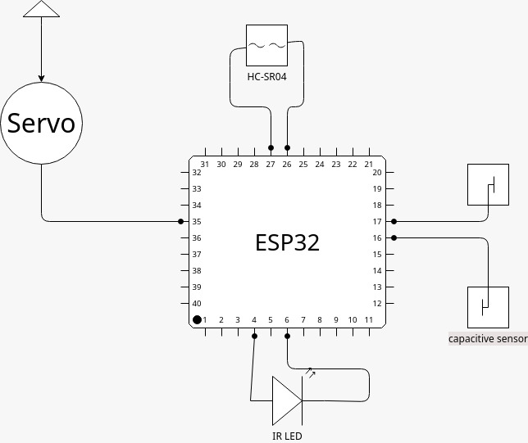
CIRCUIT DIAGRAM

Slide 16
APPLICATIONS
Household Waste Management – Automates waste segregation at homes, reducing manual effort.
Smart Cities & Public Places – Enhances waste disposal efficiency in urban areas, offices, and commercial buildings.
Recycling Centers – Improves the sorting of recyclable materials for better processing.
Hospitals & Industries – Ensures proper classification and disposal of medical and industrial waste.

Slide 17
CONCLUSION
The proposed automated waste segregation system it discusses an automated waste segregation system that efficiently classifies waste using(TTP223B,HC-SR04,IR)sensors and a(ESP32)microcontroller, reducing labor and promoting recycling. The system's cost-effectiveness and compact design make it suitable for both residential and public spaces. The automated system utilizes advanced technology to making it a valuable tool for sustainable practices. Alternatively, the system's innovative approach to waste segregation contributes to a cleaner environment by minimizing landfill waste and encouraging eco-friendly disposal methods. Overall, the system has the potential to make a positive impact on waste management.

Slide 18
FUTURE ENHANCEMENT
IoT Integration – Enables real-time monitoring and data collection for better waste management.
AI-Based Waste Classification – Uses machine learning to improve waste identification accuracy.
Automated Cleaning Mechanism – Ensures sensors and sorting components remain efficient over time.
Mobile App Connectivity – Allows users to track waste segregation statistics and receive alerts.
Smart Bin Optimization – Adaptive waste bins automatically notify users/authorities when full.

Slide 19
REFERENCES
[1] H. Tu, H. Feng, S. Srdic, and S. Lukic, “Extreme fast charging of electric vehicles: A technology overview,” IEEE Trans. Transp. Electrific., vol. 5no. 4, pp. 861–878, Dec. 2019.
[2] M. Safayatullah, M. T. Elrais, S. Ghosh, R. Rezaii, and I. Batarseh, “A comprehensive review of power converter topologies and control method for electric vehicle fast charging applications,” IEEE Access, vol. 10, pp. 40753–40793, 2022.
[3] J. Y. Lee and H.-J. Chae, “6.6-kW onboard charger design using DC PFC converter with harmonic modulation technique and two-stage DC/D converter,” IEEE Trans. Ind. Electron., vol. 61, no. 3, pp. 1243–1252, Mar. 2014.
[4] H. Wang, S. Dusmez, and A. Khaligh, “Design and analysis of a full-bridg LLC-based PEV charger optimized for wide battery voltage range,” IEEE Trans. Veh. Technol., vol. 63, no. 4, pp. 1603–1613, May 2014.
[5] S. Dutta, S. Gangavarapu, A. K. Rathore, R. K. Singh, S. K. Mishra, and V. Khadkikar, “Novel single-phase Cuk-derived bridgeless PFC converter for on-board EV charger with reduced number of components,” IEEE Trans. Ind. Appl., vol. 58, no. 3, pp. 3999–4010, May/Jun. 2022.

Slide 20
THANK YOU TO ALL

